Slide 1

Artificial Intelligence (CS-2002)
Chapter 4: Local Search Algorithm and Optimization

Slide 2
Objectives of the Chapter
Local Search: Hill Climbing
• Escaping Local Maxima: Local Beam Search
• Genetic Algorithm

Slide 3
Local Search
Use single current state and move to the neighboring state.
Idea: Start with an initial guess at a solution and incrementally improve it until it is one.

Slide 4
Local Search
Local search algorithms operate using a single current node rather than multiple paths
Move only to neighbors of that node.
The paths followed by the search are not retained.

Slide 5
Local Search Advantages
they use very little memory— usually a constant amount;
they can often find reasonable solutions in large or infinite (continuous) state spaces for which systematic algorithms are unsuitable.

Slide 6
Hill Climbing Algorithm
(Local Search, Greedy Approach, No backtrack)
In this algorithm, we don't need to maintain and handle the search tree or graph as it only keeps a single current state
Hill climbing algorithm continuously moves in the direction of increasing elevation/value to find the peak or best solution to the problem.
It terminates when it reaches a peak value where no neighbor has a higher value.
It is also called greedy local search as it only looks to its good immediate neighbor state and not beyond that.

Slide 7
Algorithm
Step 1: Evaluate the initial state, if it is goal state then return success and Stop.
Step 2: Loop Until a solution is found or there is no new operator left to apply.
Step 3: Select and apply an operator to the current state.
Step 4: Check new state:
  If it is goal state, then return success and quit.
  Else if it is better than the current state then assign new state as a current state.
  Else if not better than the current state, then return to step2.
Step 5: Exit.

Slide 8
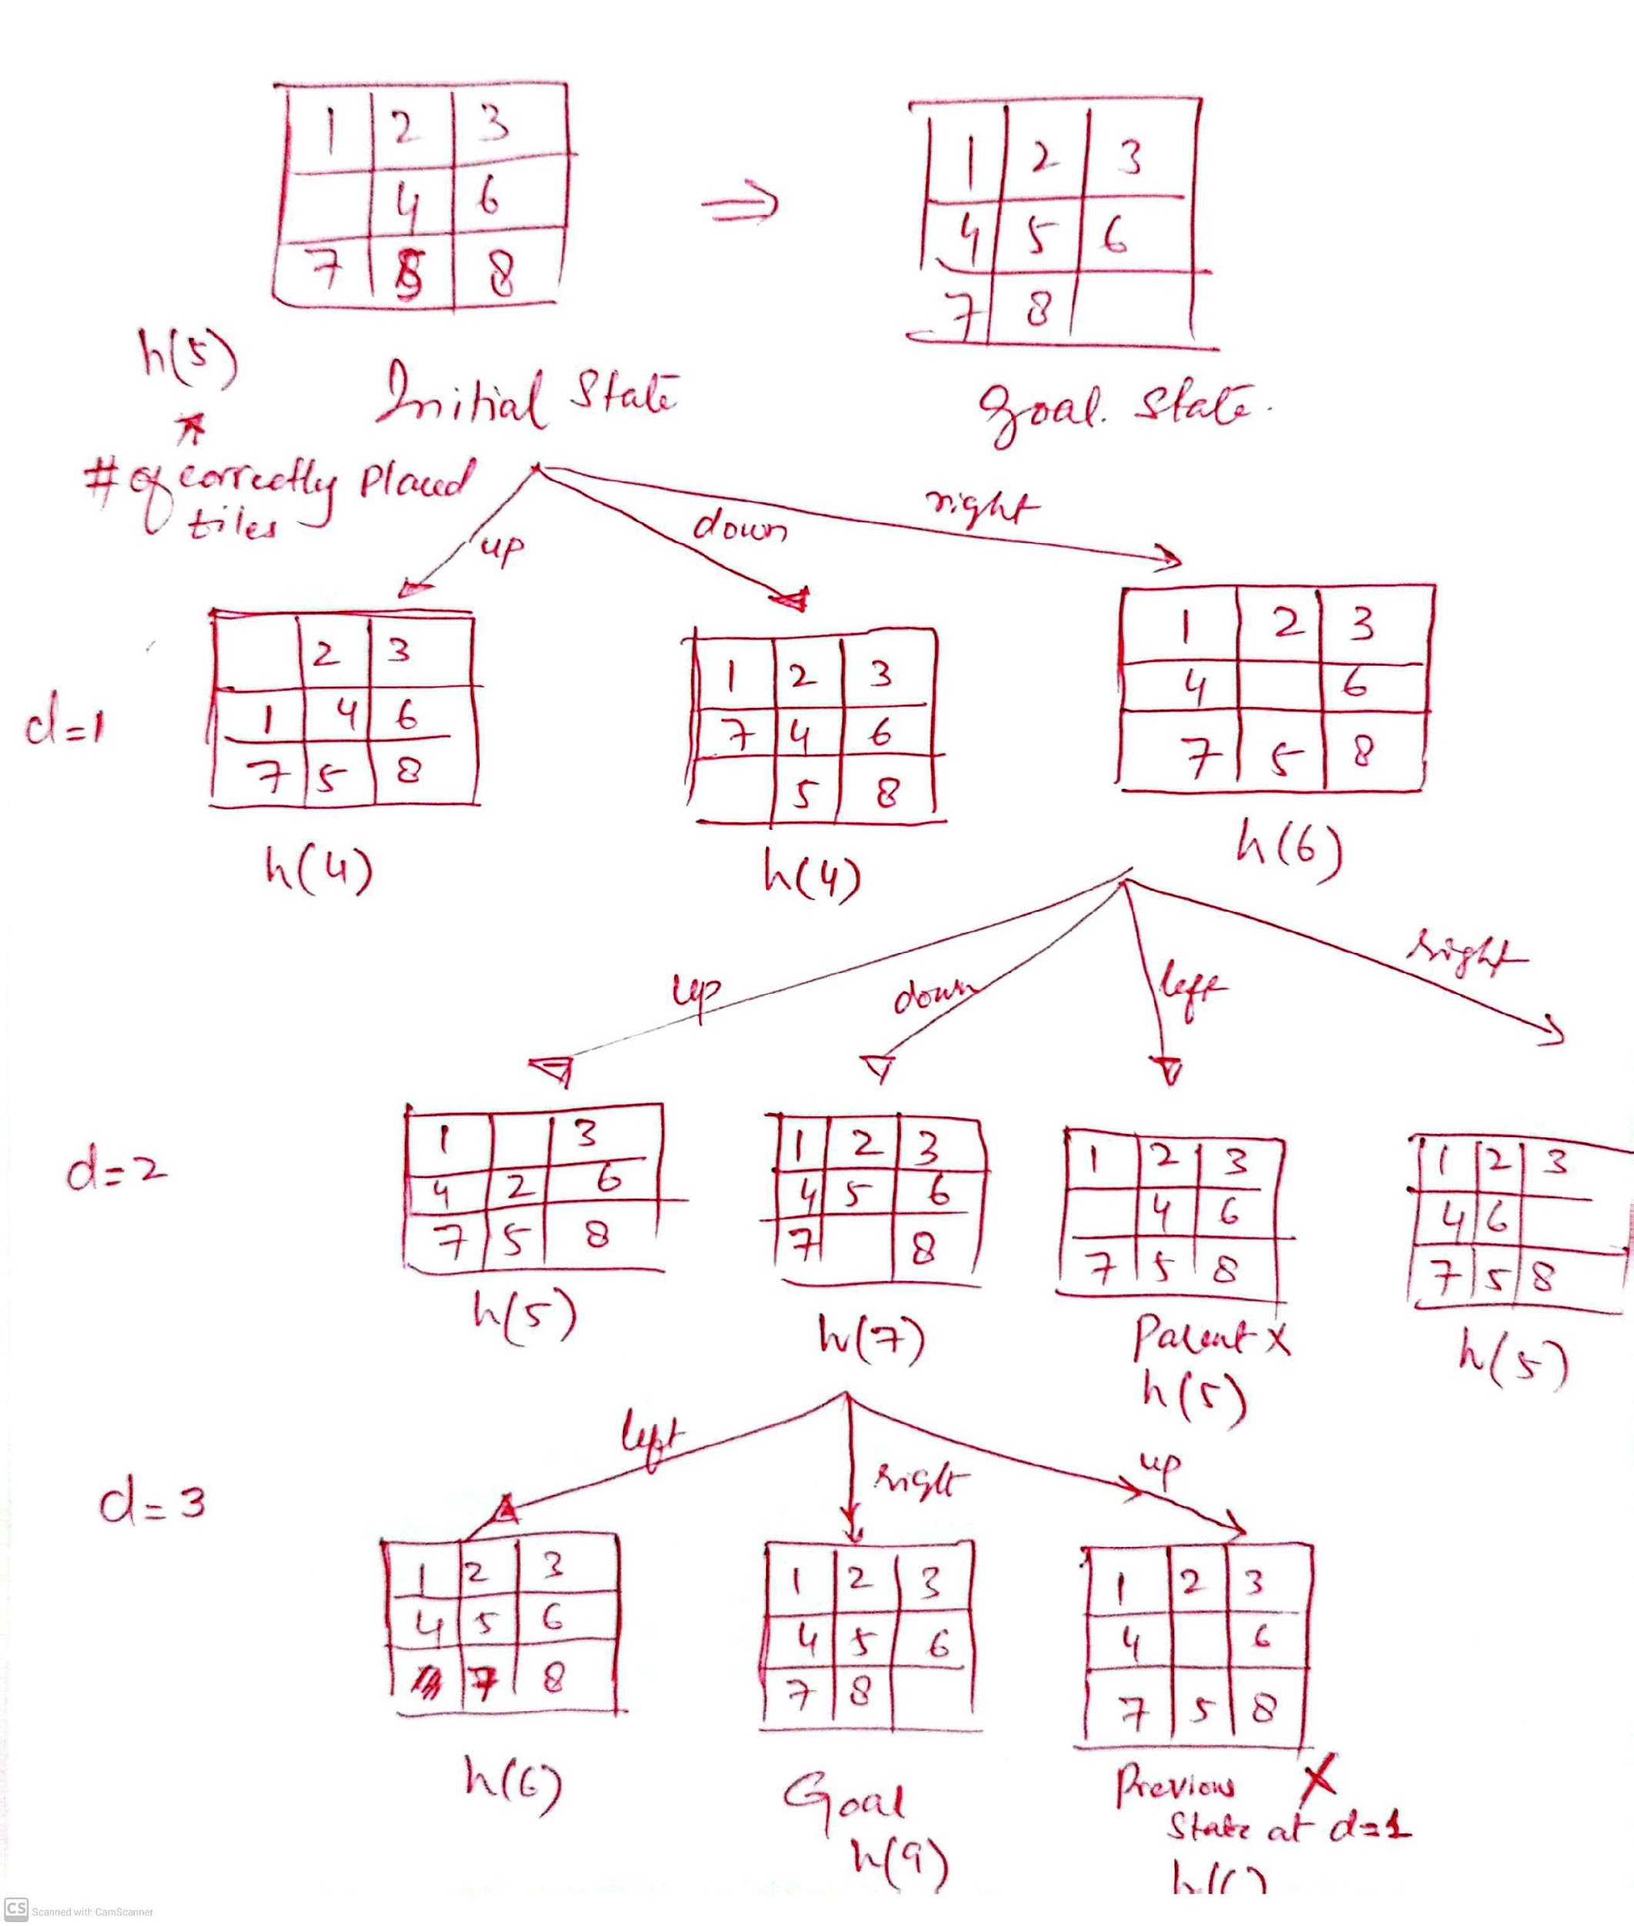
Example

Slide 9
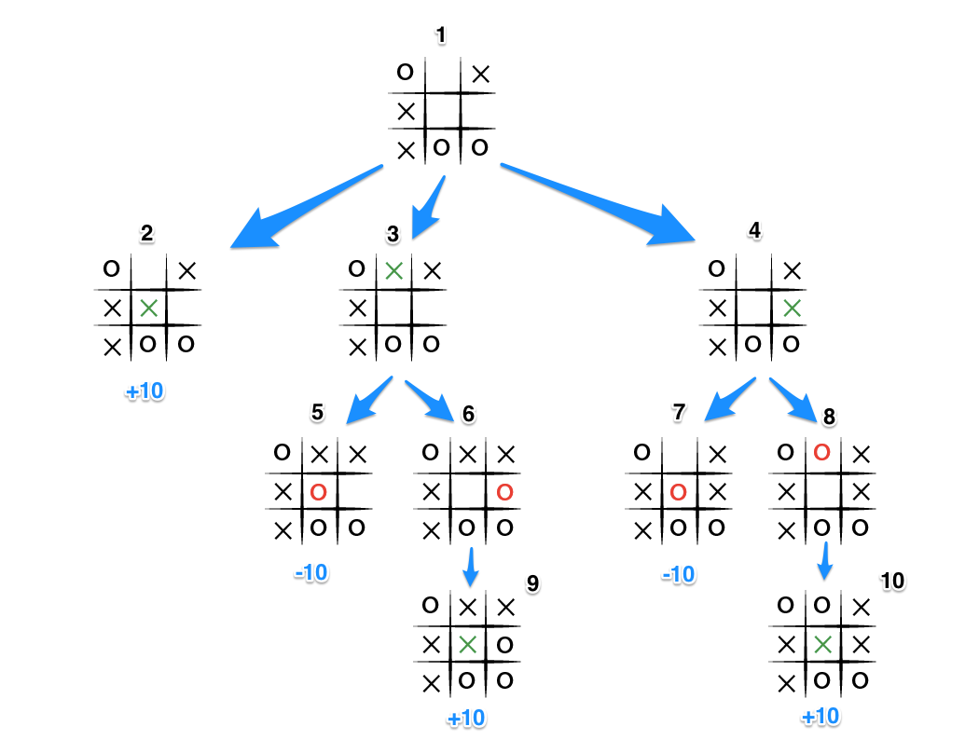

Slide 10
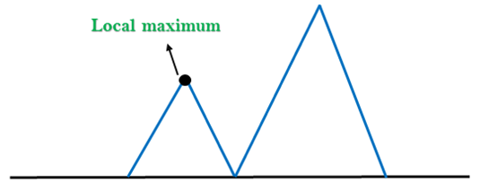

Problems in Hill Climbing
Global maximum
1. Local Maximum: A local maximum is a peak state in the landscape which is better than each of its neighboring states, but there is another state also present which is higher than the local maximum.

Slide 11
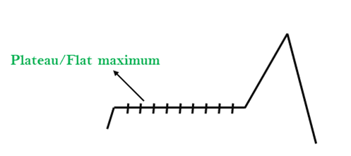
Problems in Hill Climbing….
2 Plateau: A plateau is the flat area of the search space in which all the neighbor states of the current state contains the same value, because of this algorithm does not find any best direction to move. A hill-climbing search might be lost in the plateau area.

Slide 12
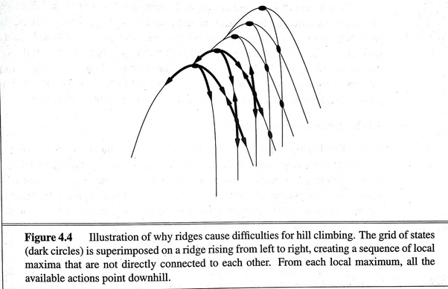
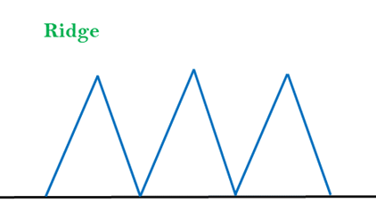
Problems in Hill Climbing…
3. Ridges: A ridge is a special form of the local maximum. It has an area which is higher than its surrounding areas, but itself has a slope, and cannot be reached in a single move.

Slide 13
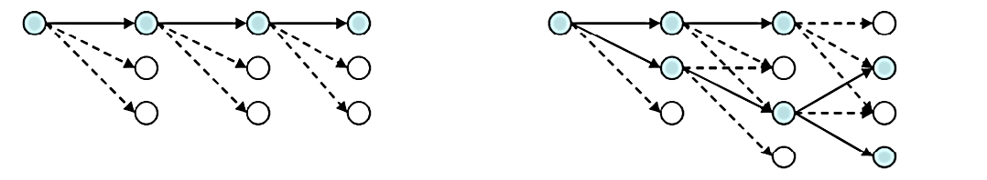
Local Beam Search
Start with k randomly generated states (ß= 2 or 3)
• At each iteration, all the successors of all k states are generated
• If any one is a goal state, stop; else select the k best successors from the complete list and successors from the complete list and repeat
Greedy Local
Local Beam

Slide 14
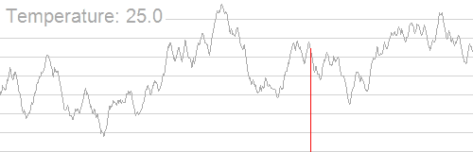
Simulated Annealing
Conceptually SA exploits an Analogy between Annealing and the Search for a minimum in a more general system
Explore Successors wildly randomly: High temp
As time goes by , explore less wildly: Cool Down
Until there’s a time when things settle: Cold

Slide 15
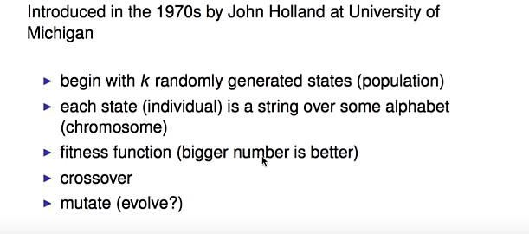
Genetic Algorithm

Slide 16
Genetic Algorithm
Twist on Local Search: successor is generated by combining two parent states
A state is represented as a string over a finite alphabet (e.g. binary)
  8-queens
    State = position of 8 queens each in a column

Slide 17
Salient Features
Evolutionary Algorithms fall into the category of “generate and test” algorithms
They are stochastic, population-based algorithms
Variation operators (recombination and mutation) create the necessary diversity and thereby facilitate novelty
Selection reduces diversity and acts as a force pushing quality

Slide 18
Typical GA
Step 1: Initialize the population randomly or with potentially good solutions.
Step 2: Compute the fitness of each individual in the population.
Step 3: Select parents using a selection procedure.
Step 4: Create offspring by crossover and mutation operators.
Step 5: Compute the fitness of the new offspring.
Step 6: Select members of population to die using a selection procedure.
Step 7: Go to Step 2 until termination criteria are met.

Slide 19
Genetic Algorithm
START
Generate the initial population
Compute fitness
REPEAT
Selection
Crossover
Mutation
Compute fitness
UNTIL population has converged
STOP

Slide 20
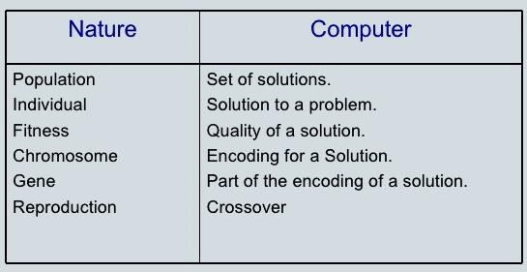
Nature of Computer Mapping

Slide 21
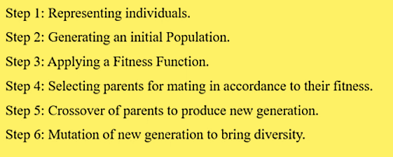
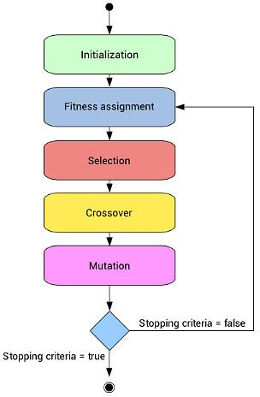
Computational Model

Slide 22
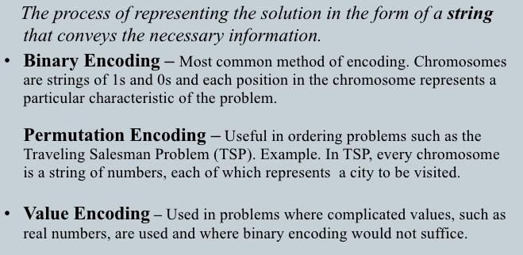
Encoding

Slide 23
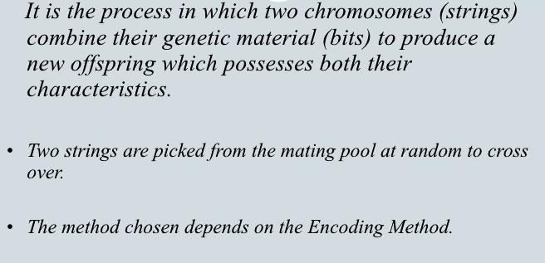
Crossover

Slide 24
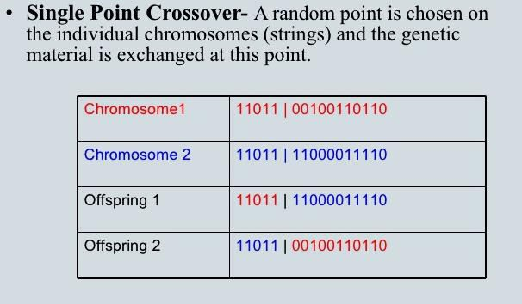
Crossover

Slide 25
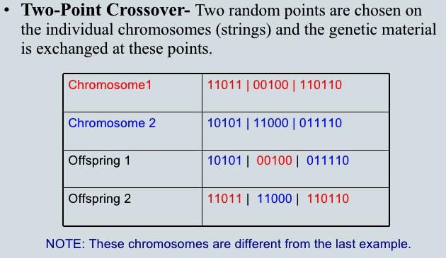
Crossover

Slide 26
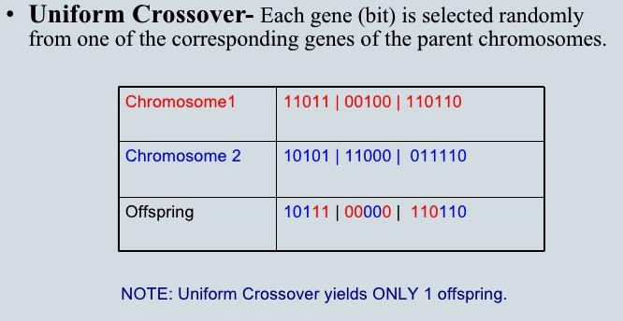
Crossover

Slide 27
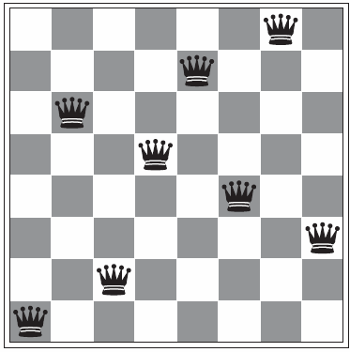
Example: 8 Queens
1 2 3 4 5 6 7 8
Population:
  Row of queen in each column.
  [1,6,2,5,7,4,8,3]
Fitness Function
  Number of non-attacking pairs of queens

Slide 28
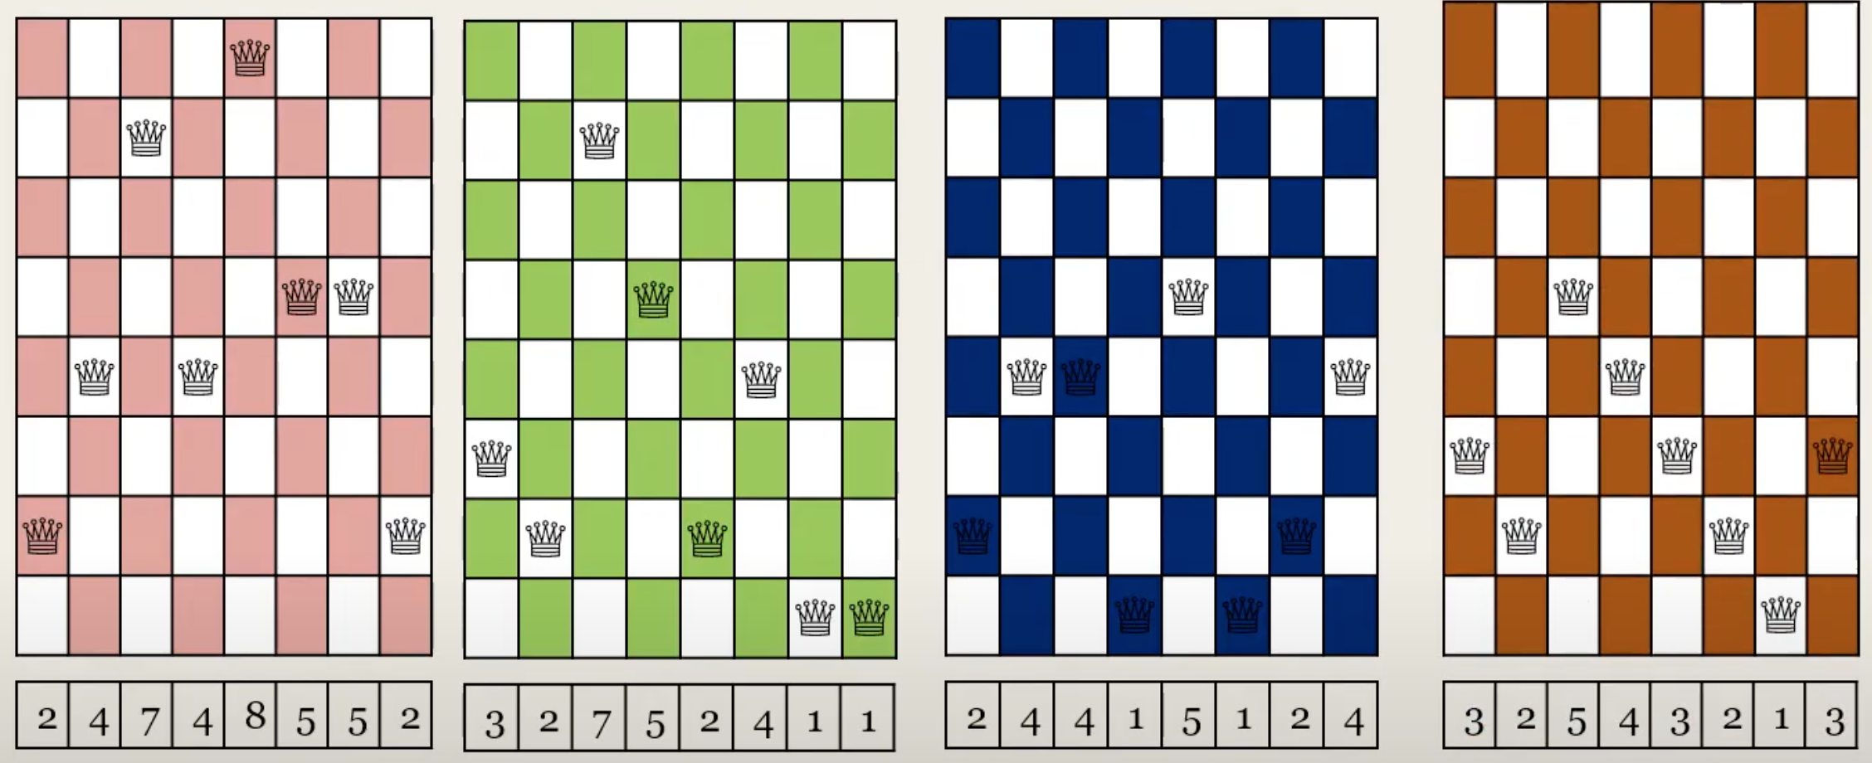
Initial Population

Slide 29
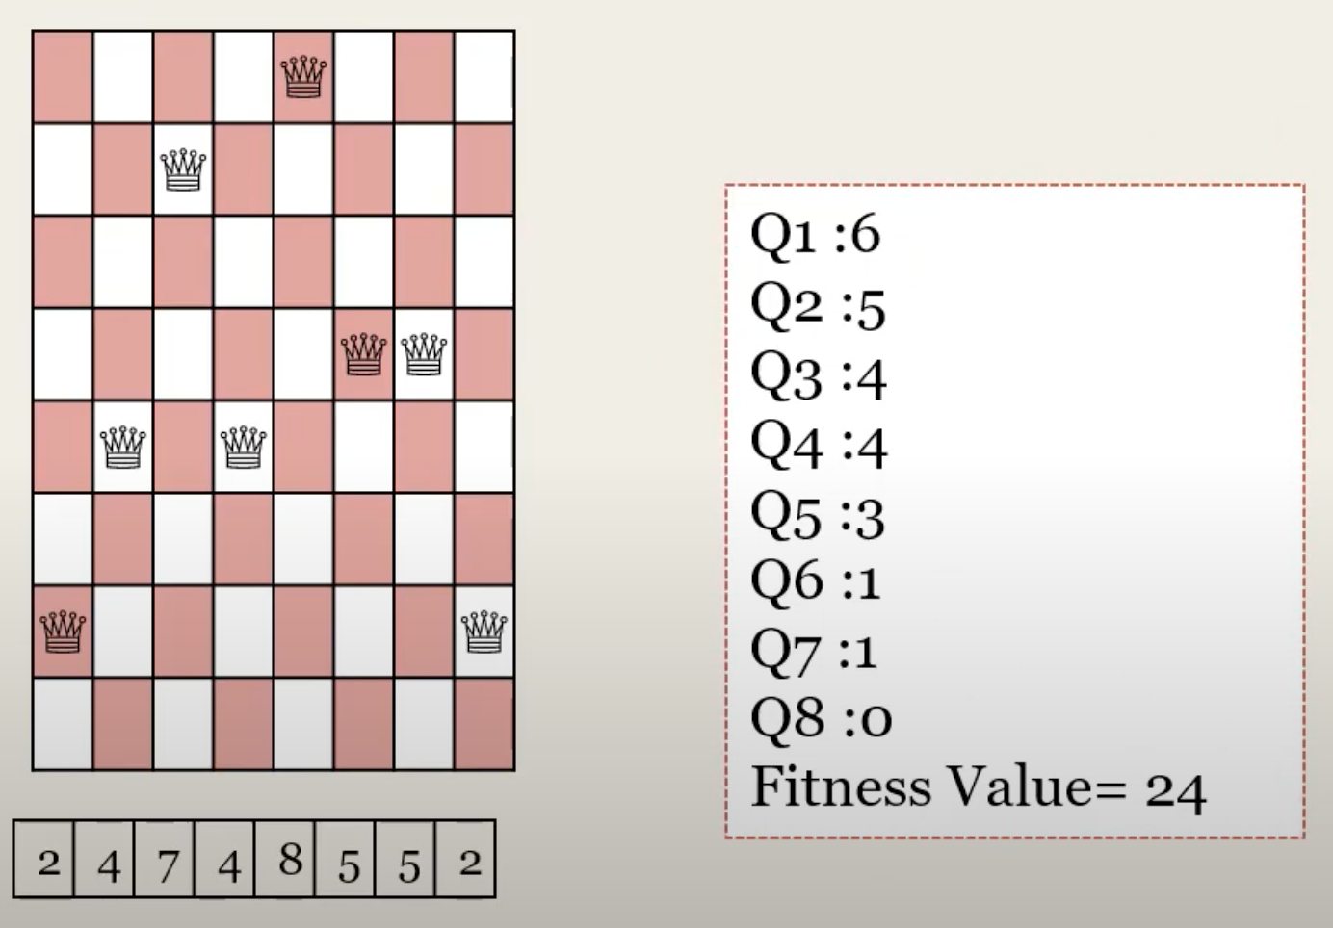

Slide 30
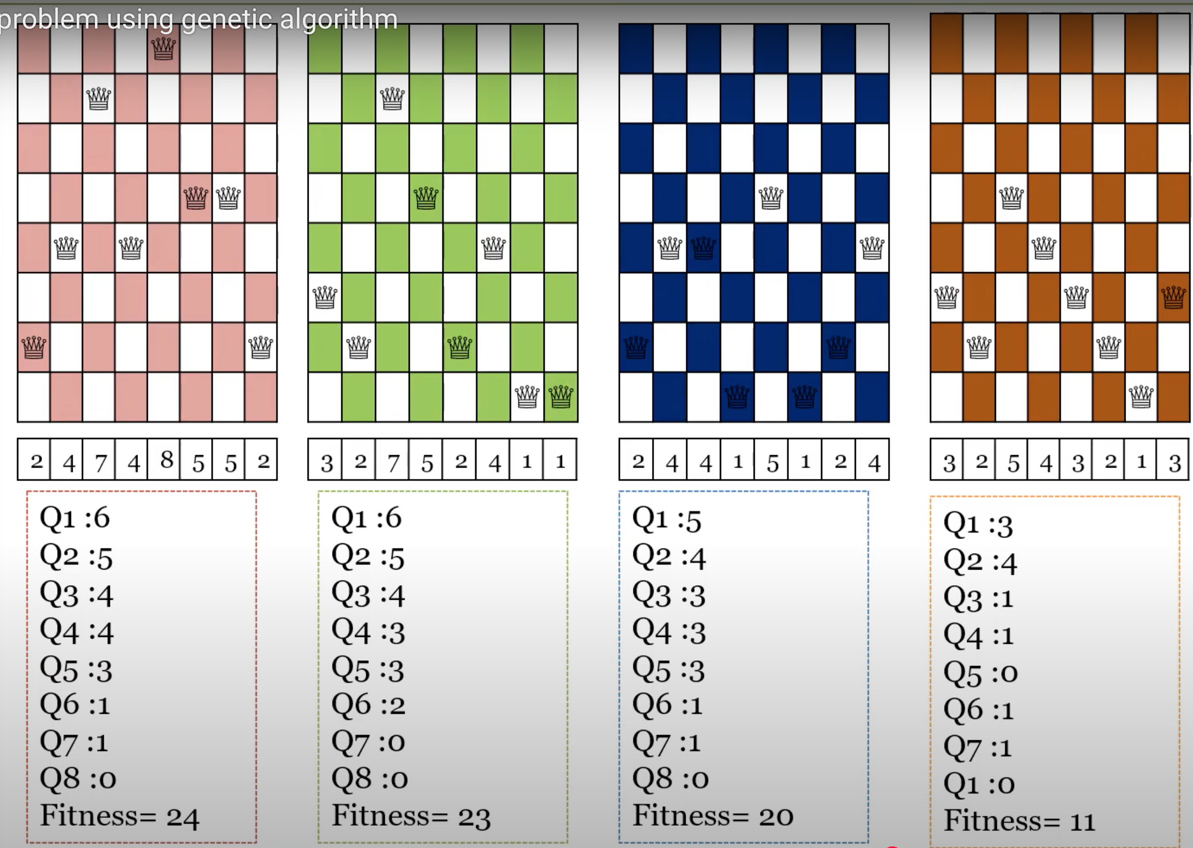
https://youtu.be/gxGe2v7c5E8?si=298ujwPYalxoNrdz

Slide 31
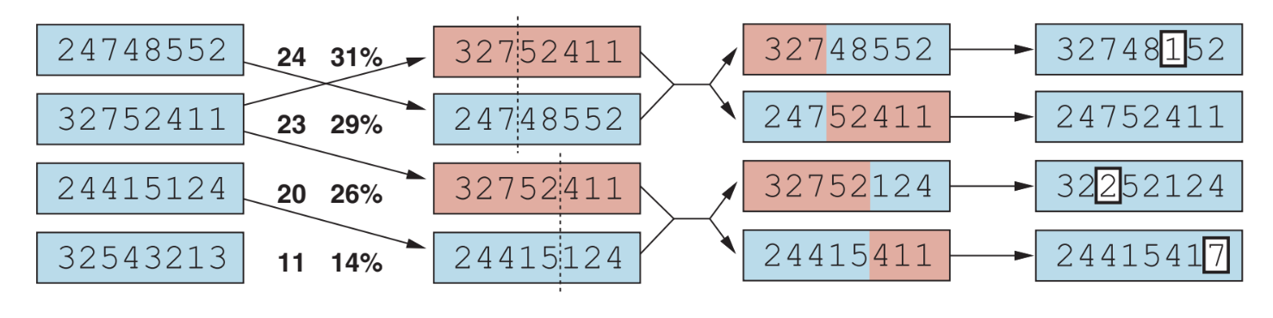
8 Queen Problem

Slide 32
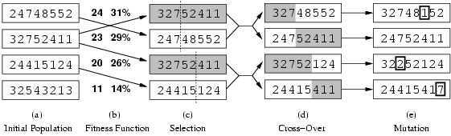
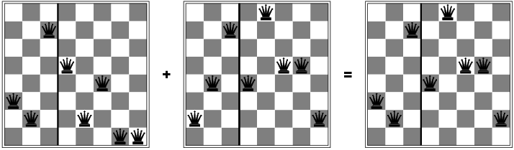
Fitness function: #non-attacking queen pairs
  min = 0, max = 8 × 7/2 = 28
Σ_{i} fitness_i = 24+23+20+11 = 78
P(pick child_1 for next gen.) = fitness_1/(Σ_i fitness_i) = 24/78 = 31%
P(pick child_2 for next gen.) = fitness_2/(Σ_i fitness_i) = 23/78 = 29%; etc
fitness =
#non-attacking
queens
probability of being
in next generation =
fitness/(Σ_i fitness_i)
How to convert a fitness value into a probability of being in the next generation.

Slide 33
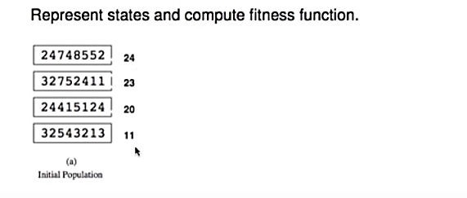
Fitness function
Probability= 24+23+20+11= 78

Slide 34
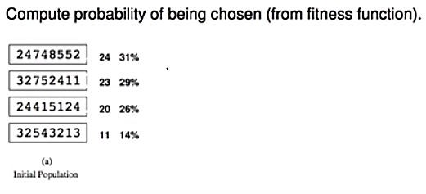
Probability
24/78= 0.307 Normalize 0.307× 100 = 30.7%
chance of being chosen probably

Slide 35
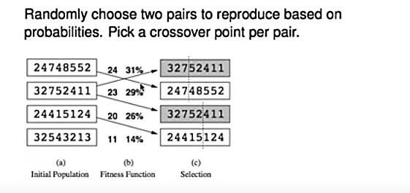
Reproduction

Slide 36
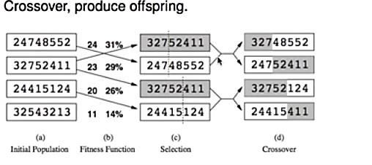
Crossover

Slide 37
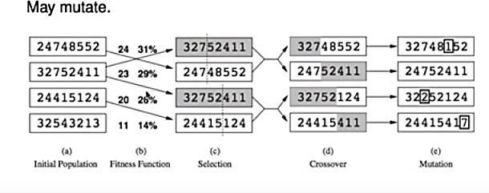
Mutation

Slide 38
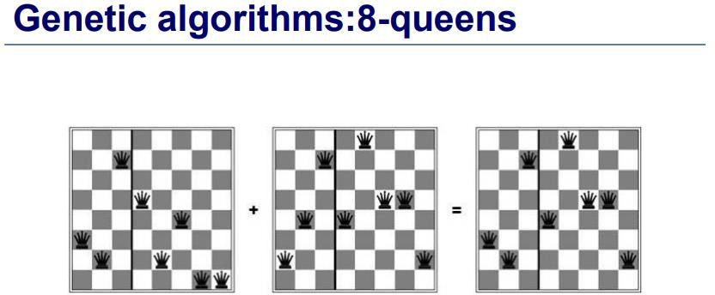

Slide 39
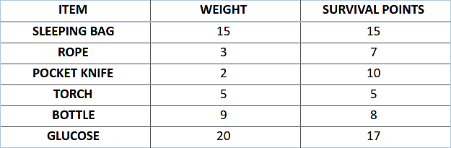
Knapsack Problem
Let’s say, you are going to spend a month in the wilderness. Only thing you are carrying is the backpack which can hold a maximum weight of 30 kg. Now you have different survival items, each having its own “Survival Points” (which are given for each item in the table). So, your objective is maximize the survival points.
Here is the table giving details about each item.

Slide 40
Choose an initial population of four. Then choose best three subsequently (Encoding hint: 1 if item is chosen 0 otherwise)
Decide crossover point.
Chance of mutation = 50 items in 100 generations.
Step by step solution ahead

Slide 41
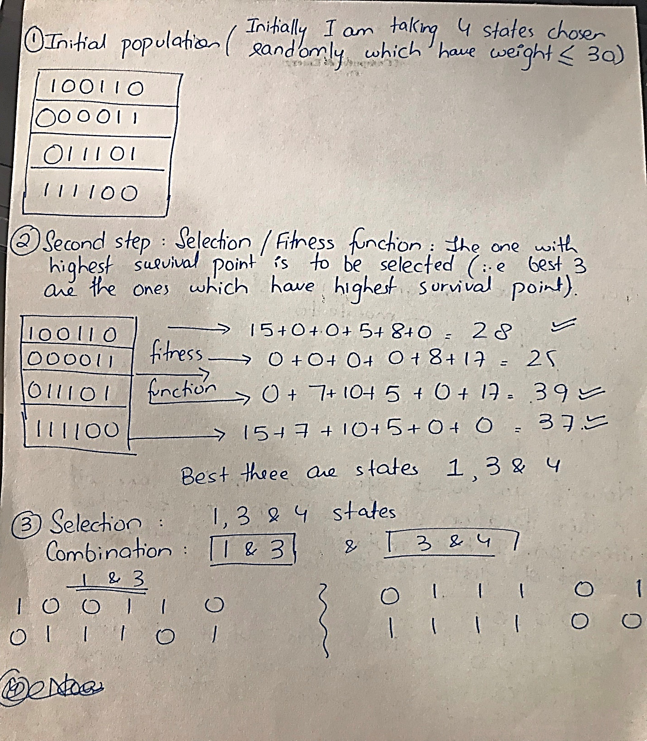

Slide 42
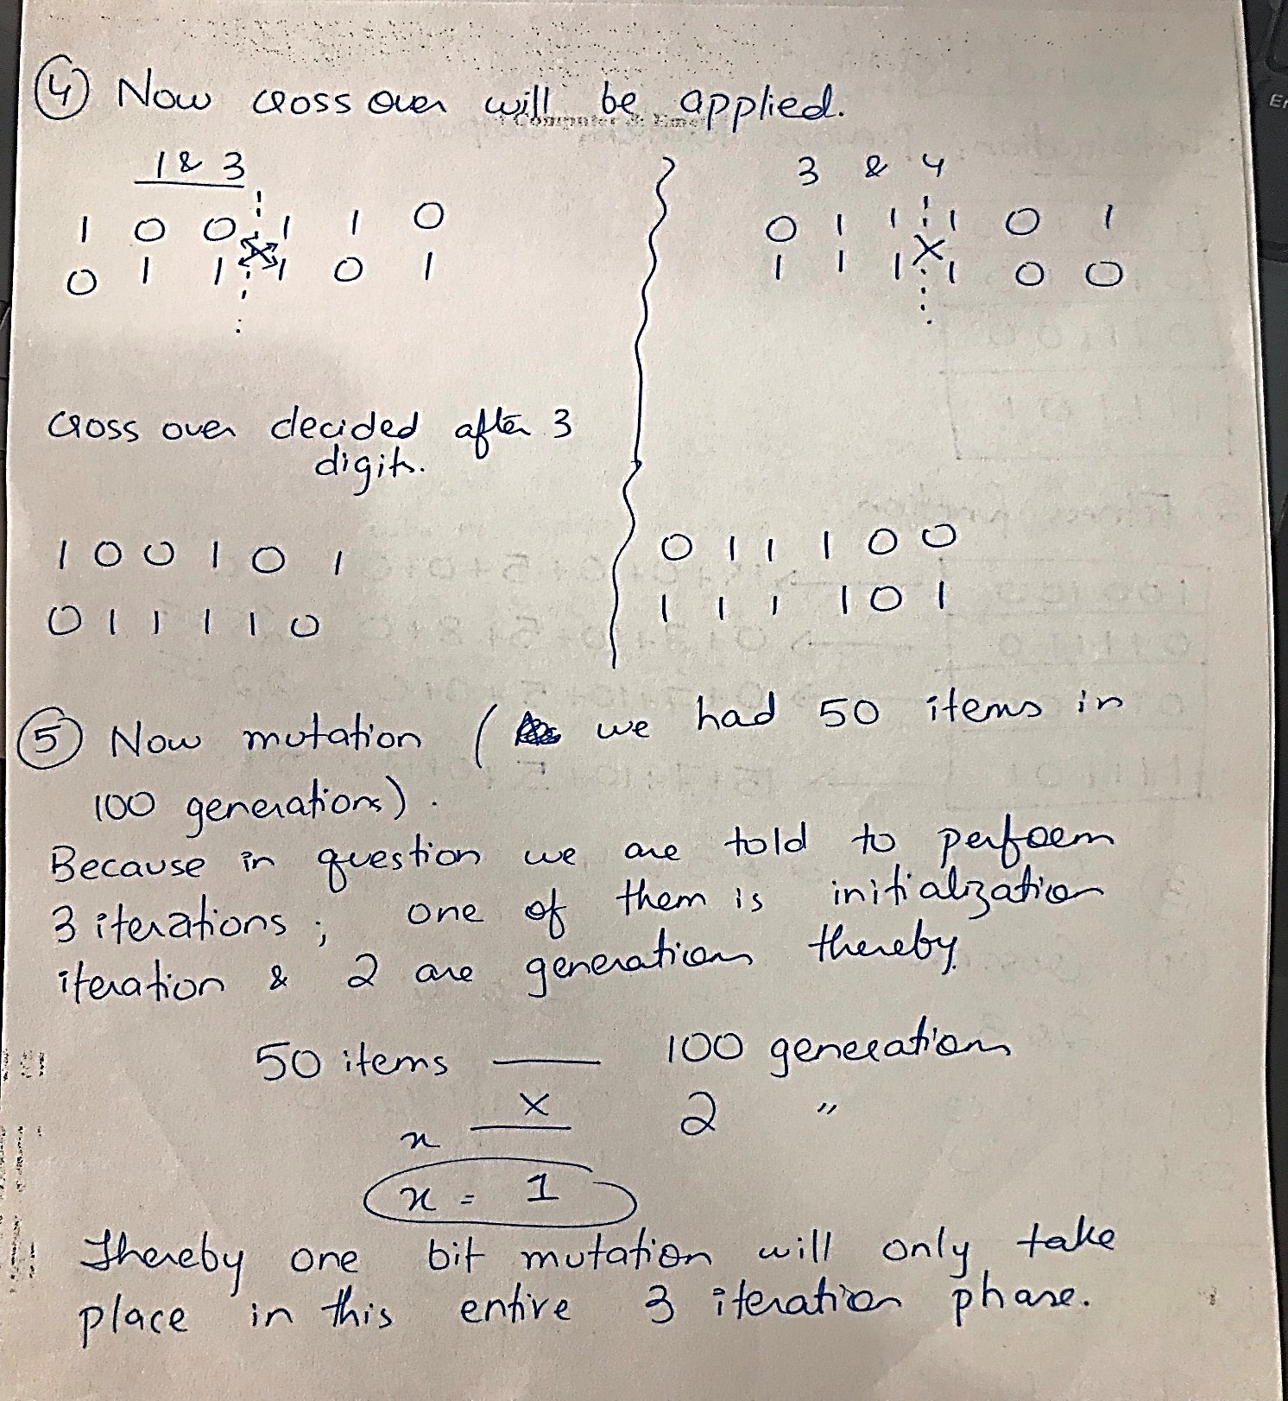

Slide 43
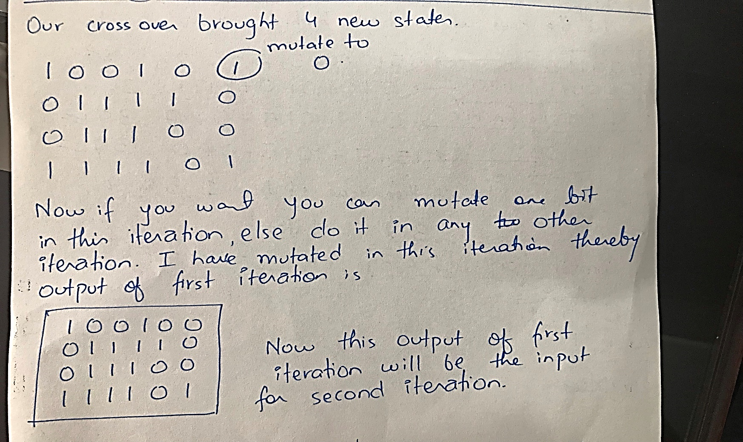

Slide 44
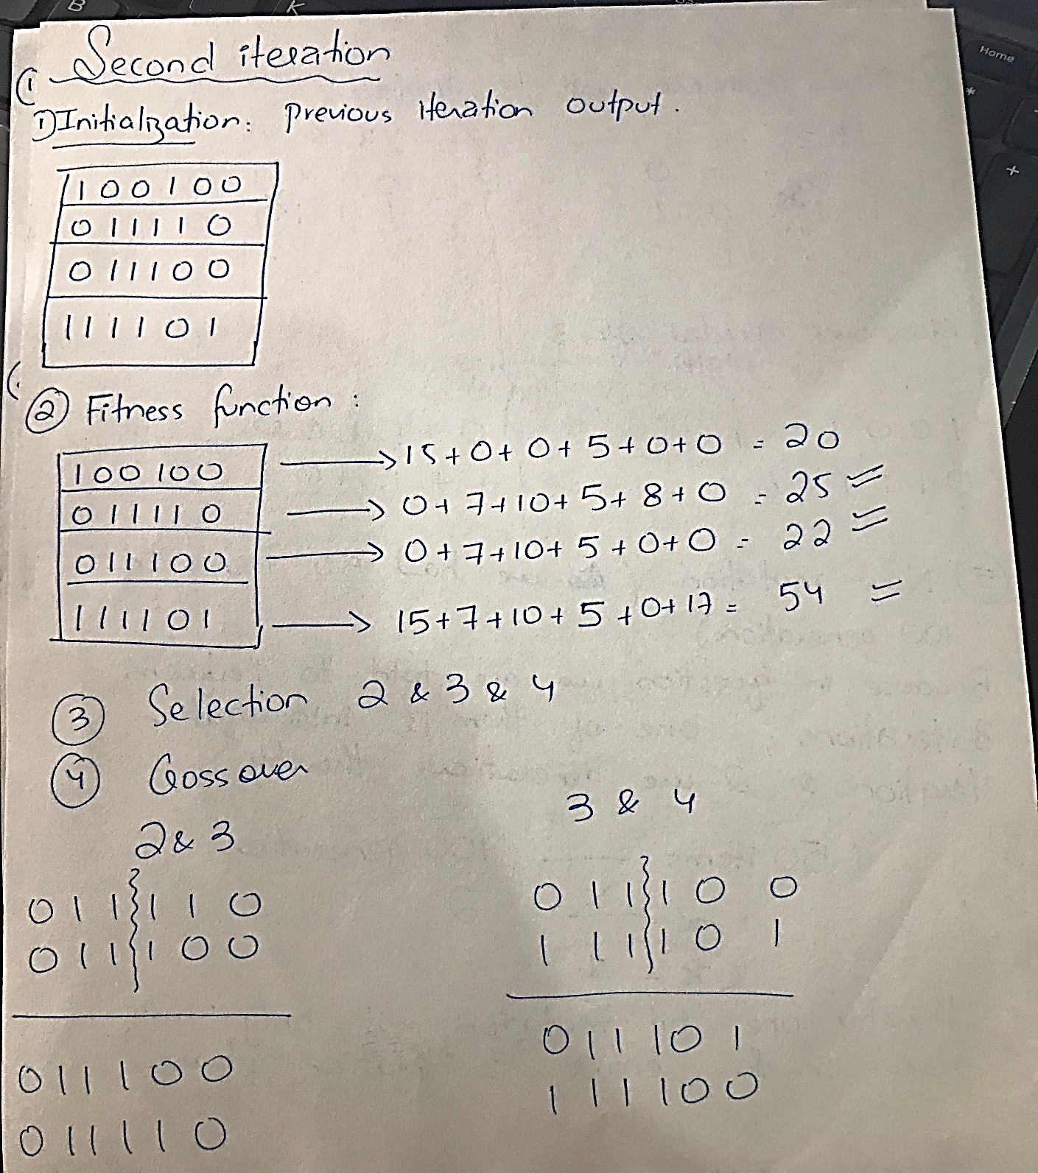

Slide 45
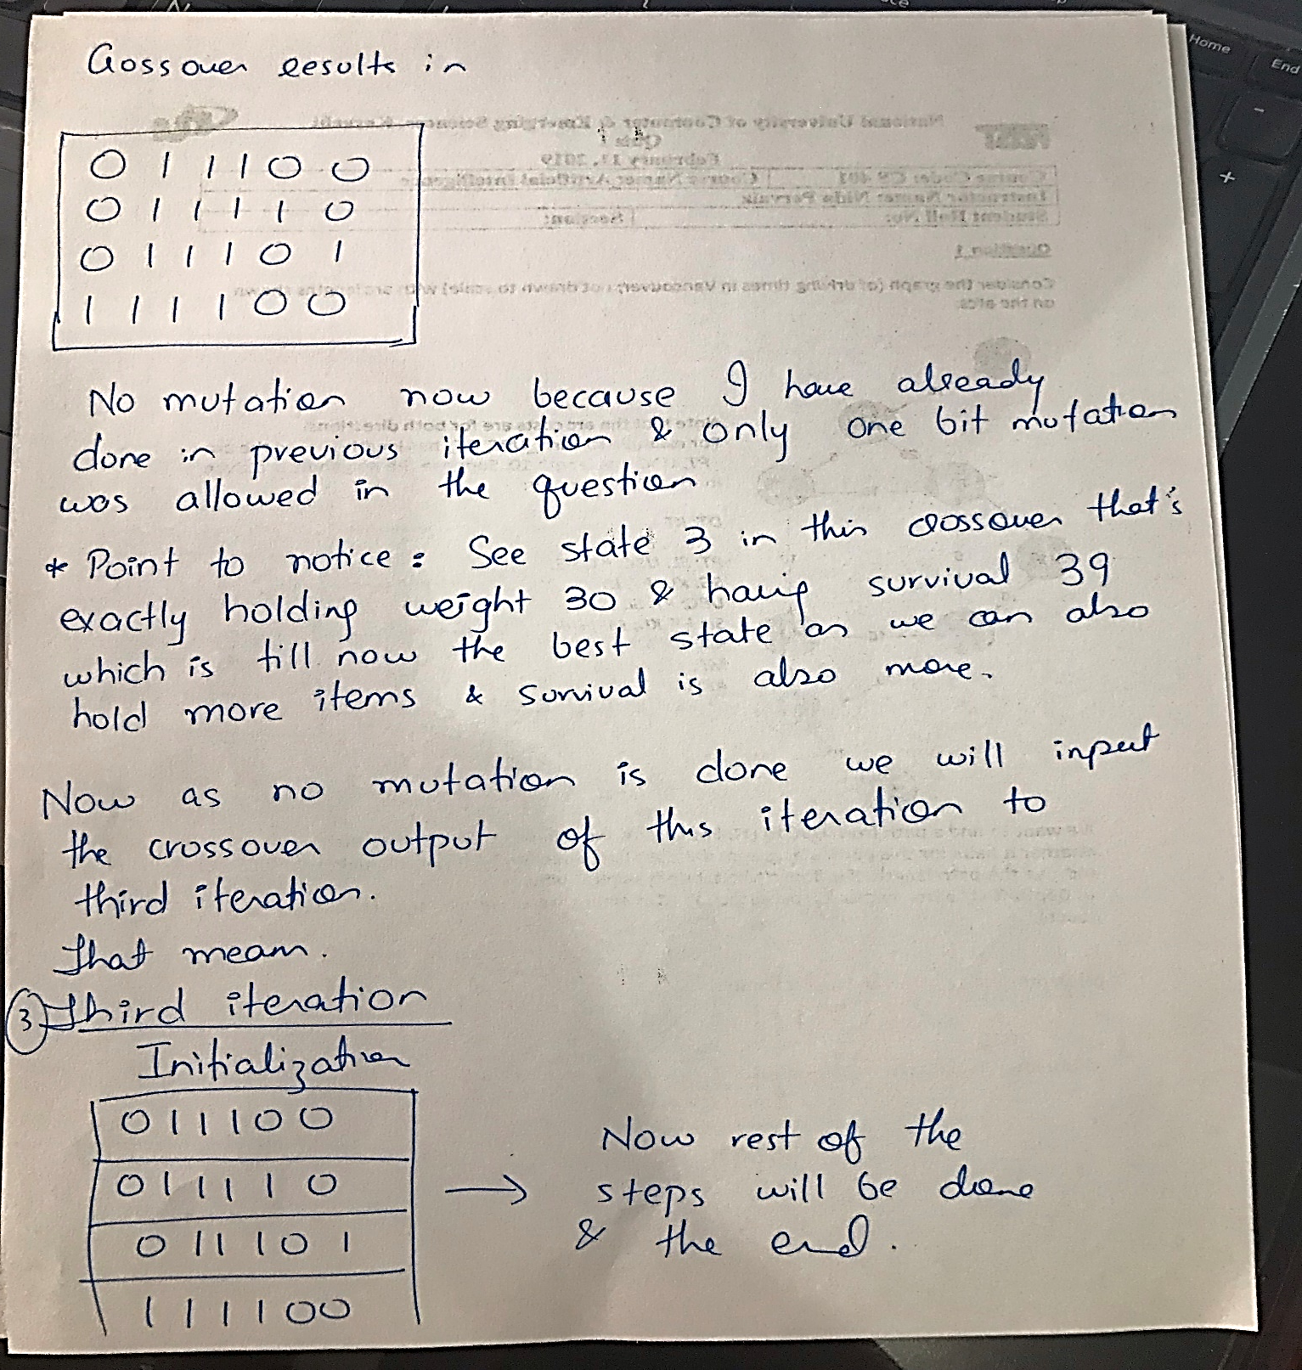
You can do the third iteration on your own now. First two iterations have been done by me.

Slide 46
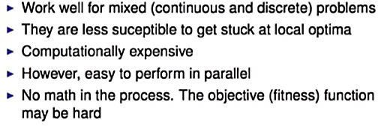
Properties

